Slide 1
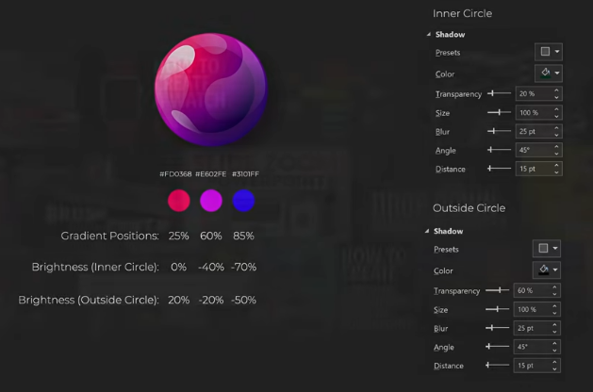
*HSL is used for colours
H: 238, S: 225, L: 128; with H reduced by 30 for each colour
GLOSSY ball
Using a triangle to edit the points to make the inner droplet like shapes and adjusting the transparency.

Slide 2
For creating the big droplet-like shape
Intersect it with the outer circle

Slide 3
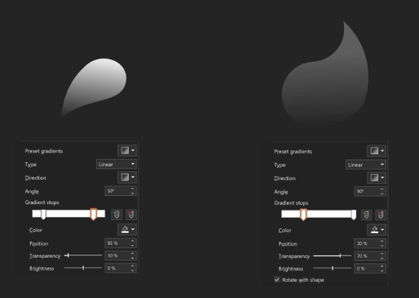

Slide 4
